Slide 1
Zerodha Images
Ambika

Slide 2
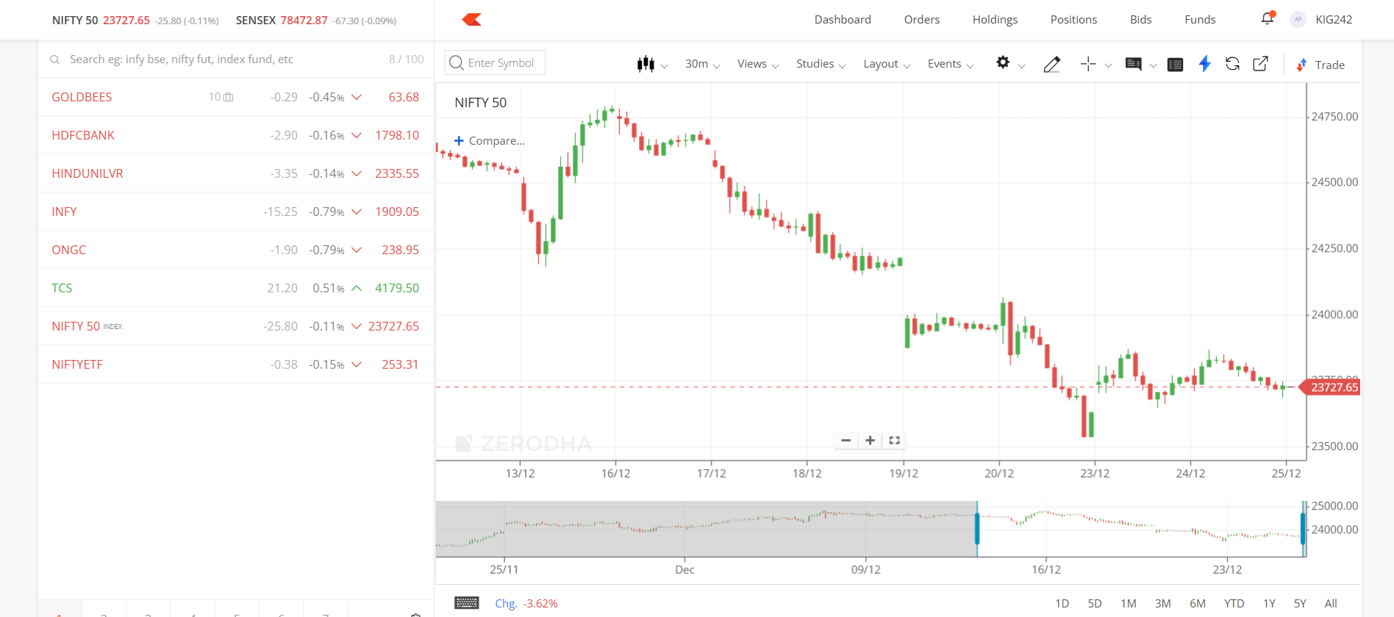
Notes:
Arrow part is NOT required.

Slide 3
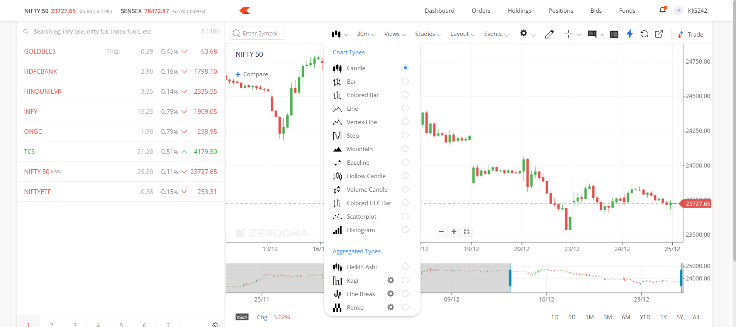
Notes:
Red Circle is a drop down list showing different plot types

Slide 4
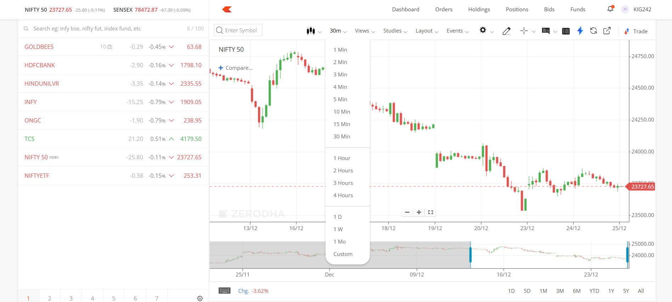
Notes:
Red circle: Drop down list to choose the time duration

Slide 5
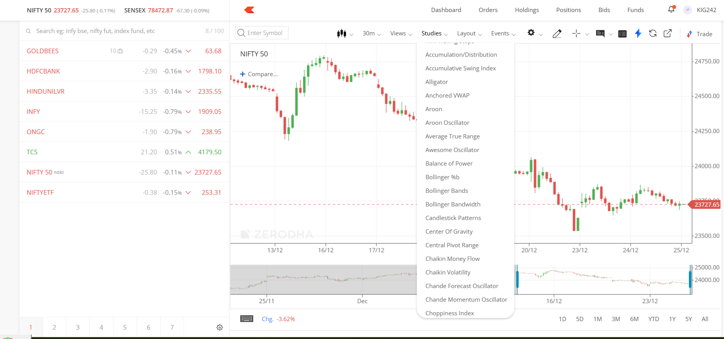
Notes:
Studies: This rolling drop down list should allow to choose any technical indicator to be drawn from the TA Lib package

Slide 6
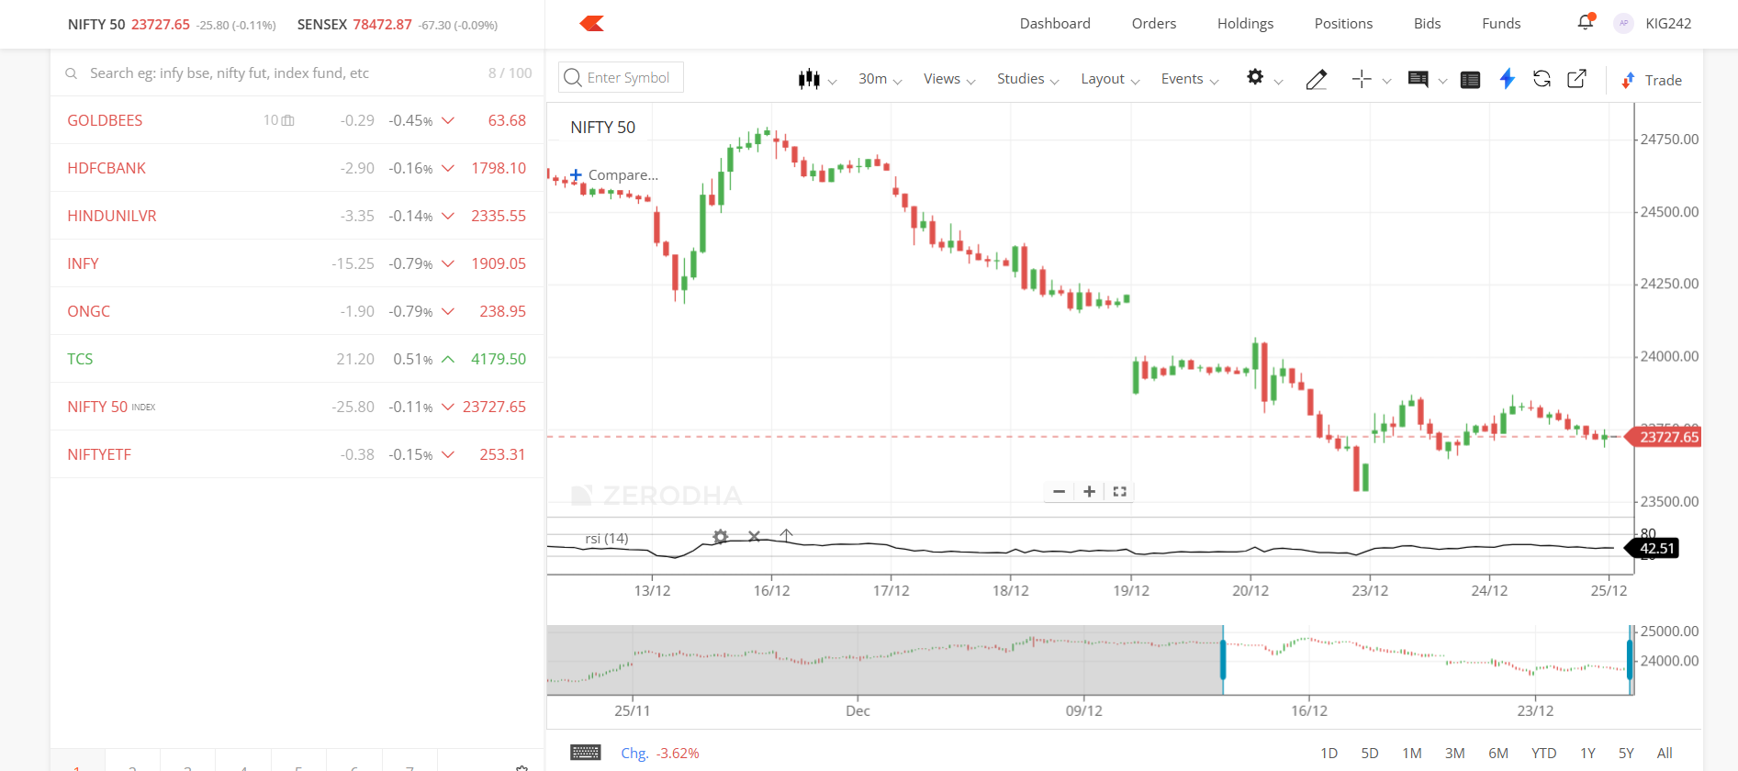
Notes:
Second panel where additional plot comes e.g. RSI from the studies drop down list

